Slide 1


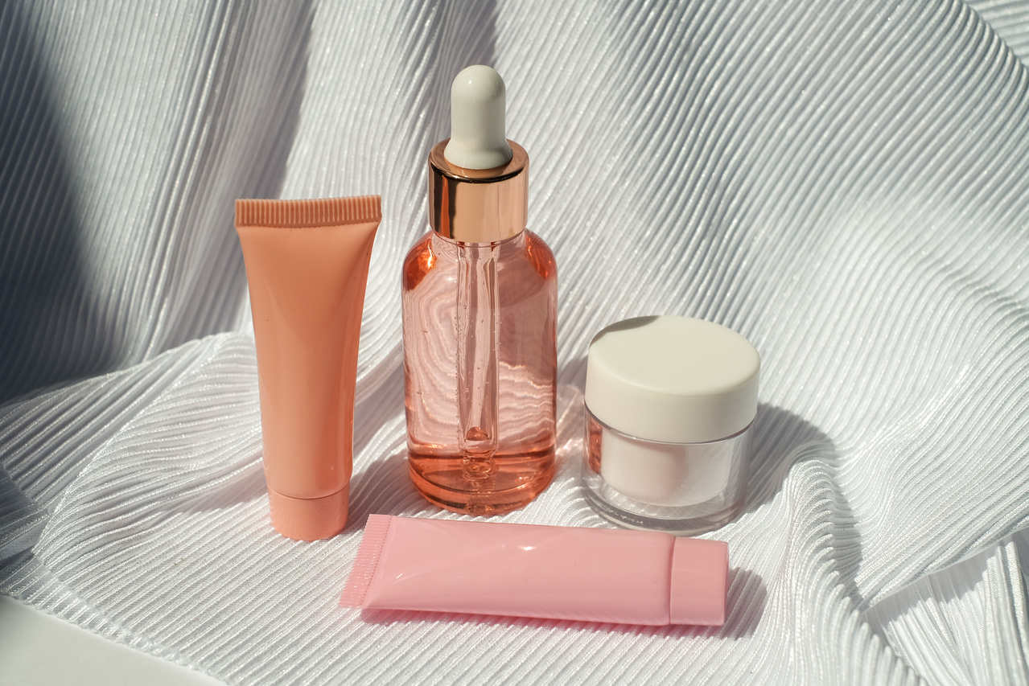
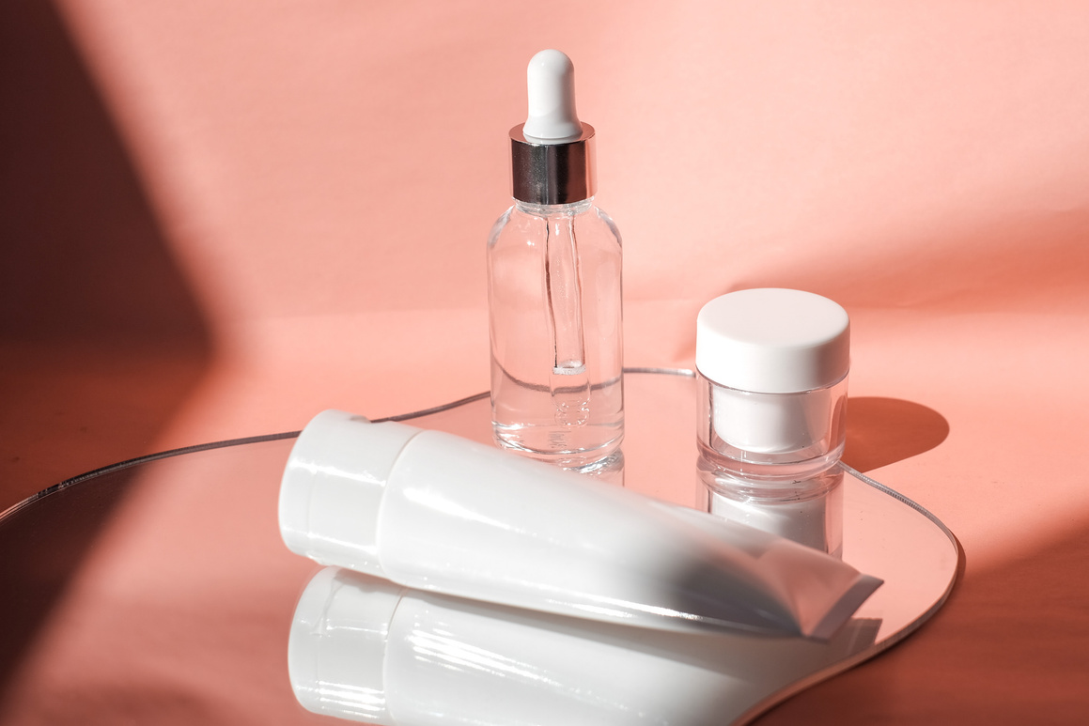
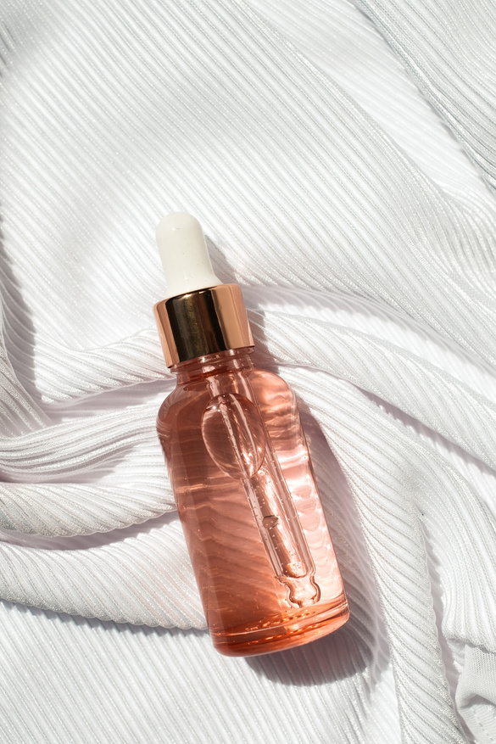
Glow up
by Nour mohammed

Slide 2
Project Idea
•Create a simple and attractive online store for girls to browse and purchase beauty products easily.

Slide 3
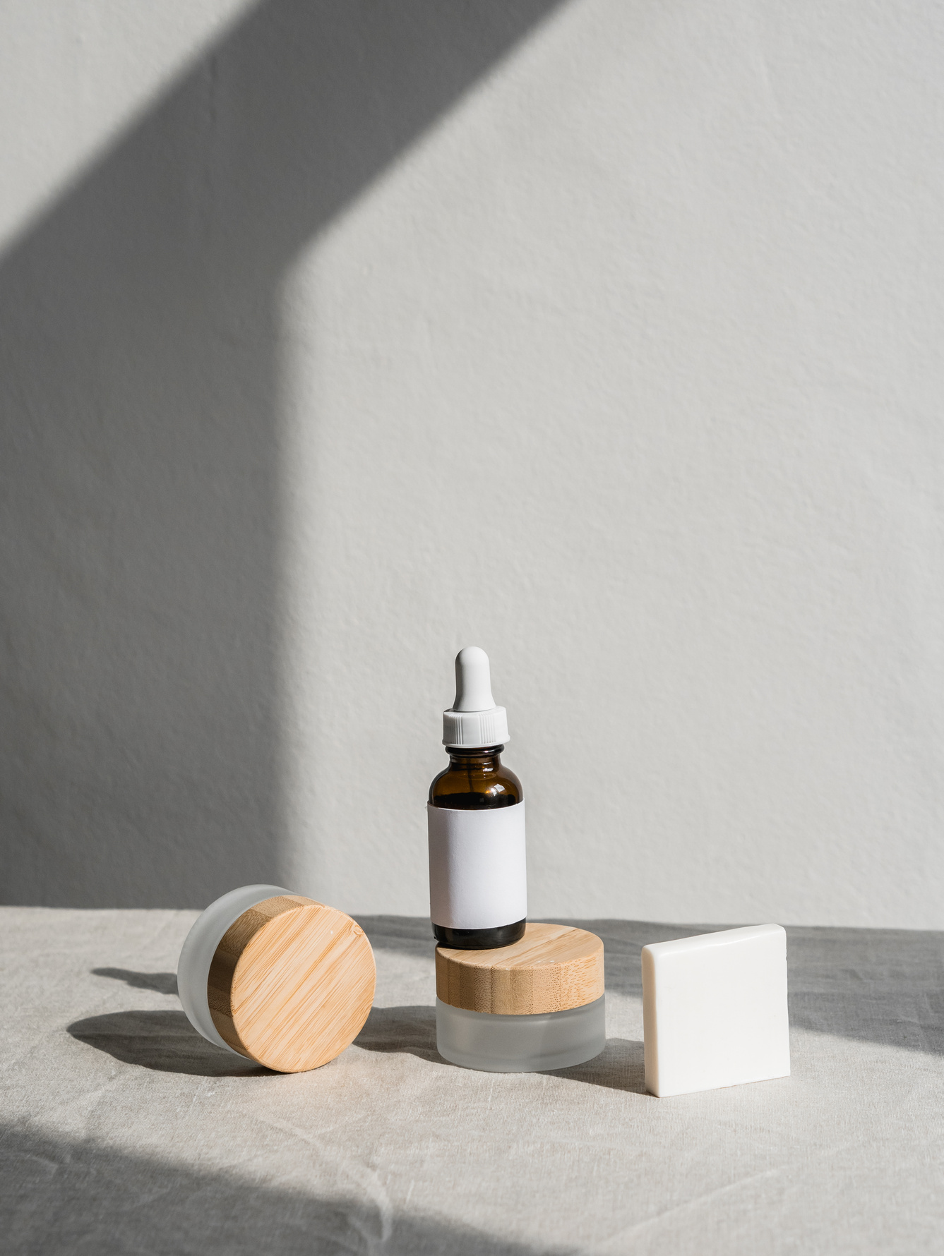
Design
•Modern and clean UI
•Responsive design
•Easy navigation
•User-friendly layout

Slide 4
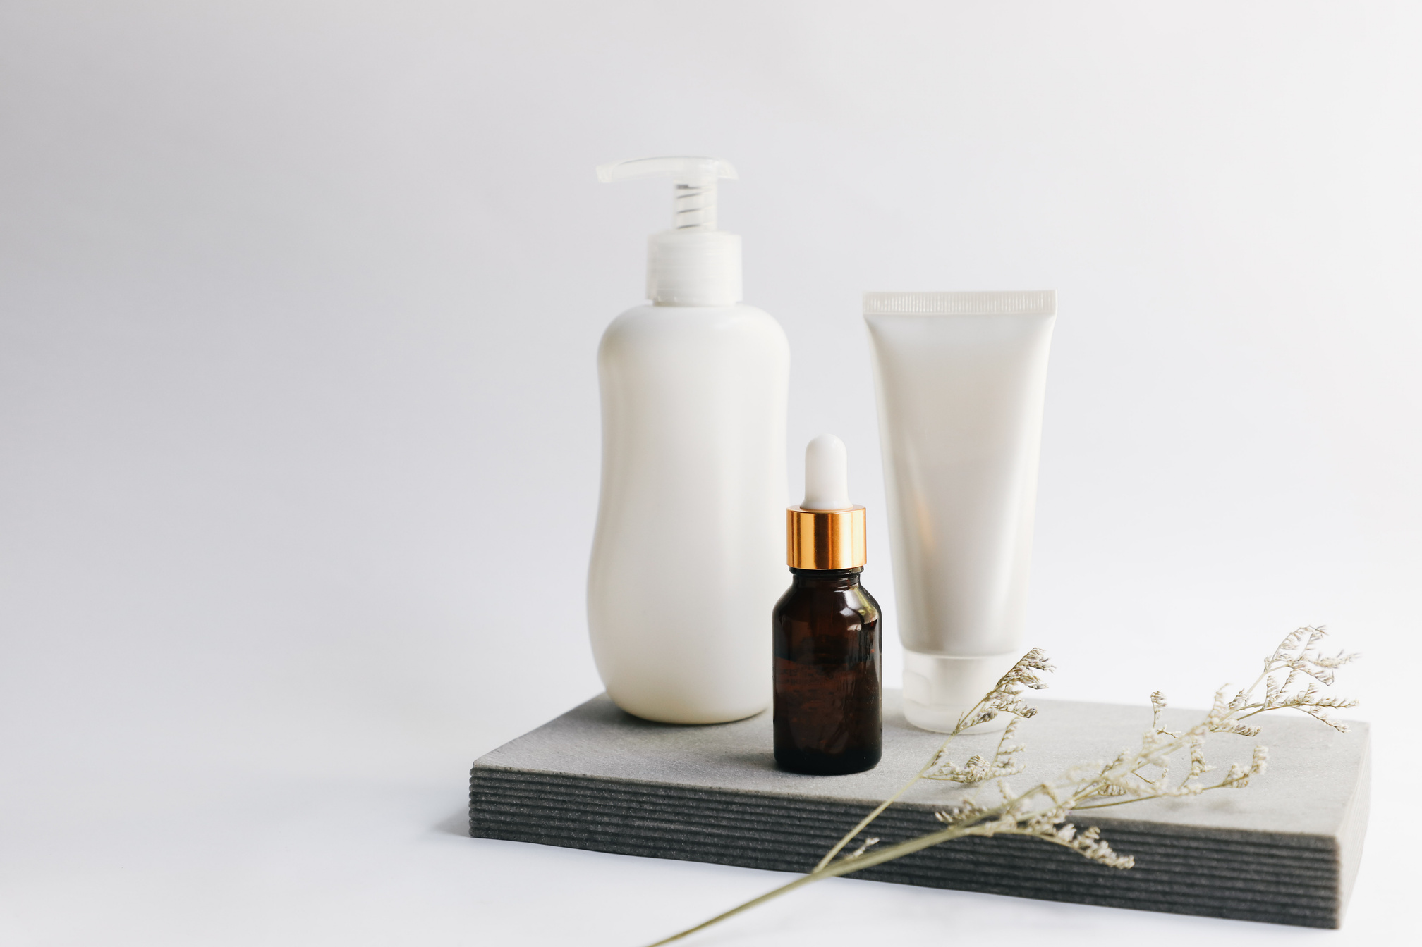
Technologies Used
•HTML
•CSS
•JavaScript
•Local Storage (for cart data)
•GitHub Pages (Hosting)

Slide 5
Key Features
•Product listing
•Product details page
•Simple shopping experience
•Responsive design
•Local storage cart system

Slide 6
Challenges
•Managing data without backend
•Using Local Storage effectively
•Ensuring responsive design
•Organizing product structure

Slide 7
Project Link
https://nour-abdalrhman.github.io/Glow-Up/

